Slide 1
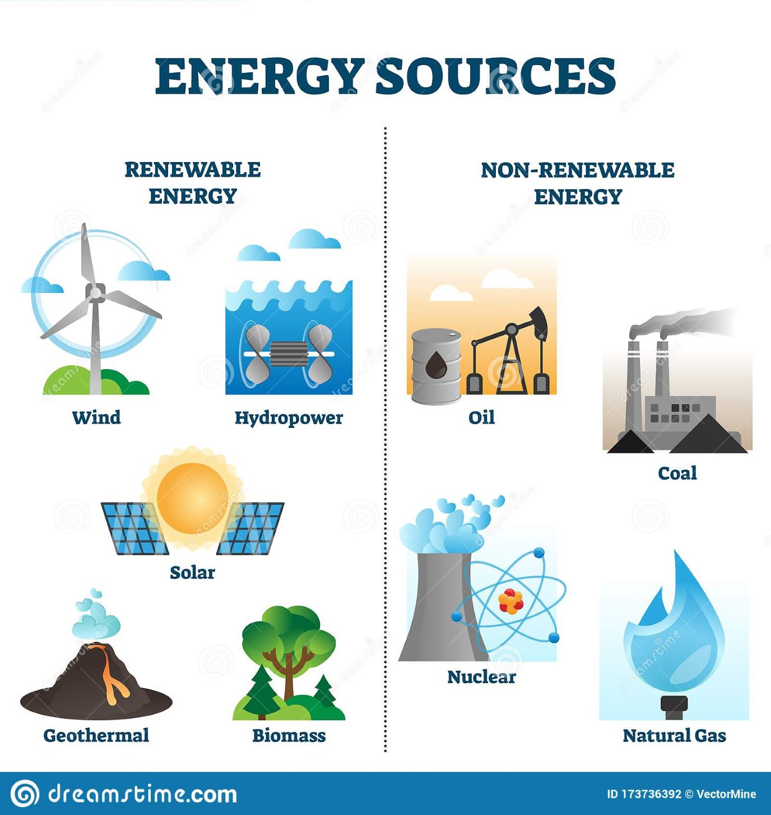
2.3 ENERGY RESOURCES
Types, uses, demand for energy
Drawbacks and Advantages.

Slide 2

Energy types- Uses

Slide 3
Energy types & Uses
Energy is “the capacity to do work”
Found on our planet in a variety of forms, some of which are immediately useful to do work, while others require a process of transformation.
The sun is the primary energy source in our lives.
We use it directly for its warmth and through various natural processes that provide us with food, water, fuel and shelter.
The sun’s rays power the growth of plants, by photosynthesis which form our food material, give off oxygen which we breathe in and take up carbon dioxide that we breathe out.

Slide 4
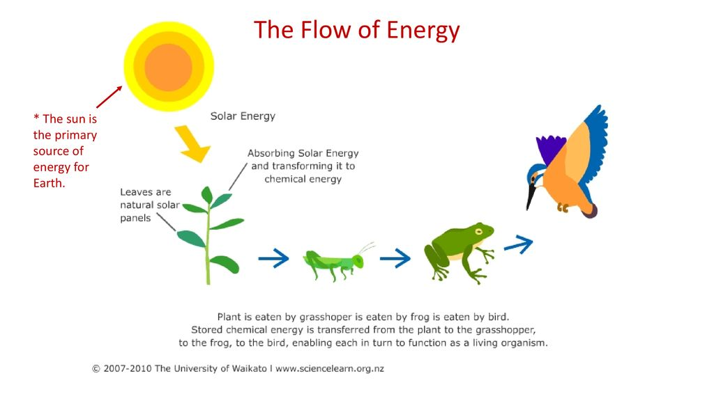
The Sun PRIMARY SPURCE OF ENERGY

Slide 5
Energy types & Uses
Energy from the Sun evaporates water from oceans, rivers and lakes, to form clouds that turn into rain.
Today’s fossil fuels were once the forests that grew in prehistoric times due to the energy of the sun.
Chemical energy, contained in chemical compounds is released when they are broken down by animals in the presence of oxygen.

Slide 6
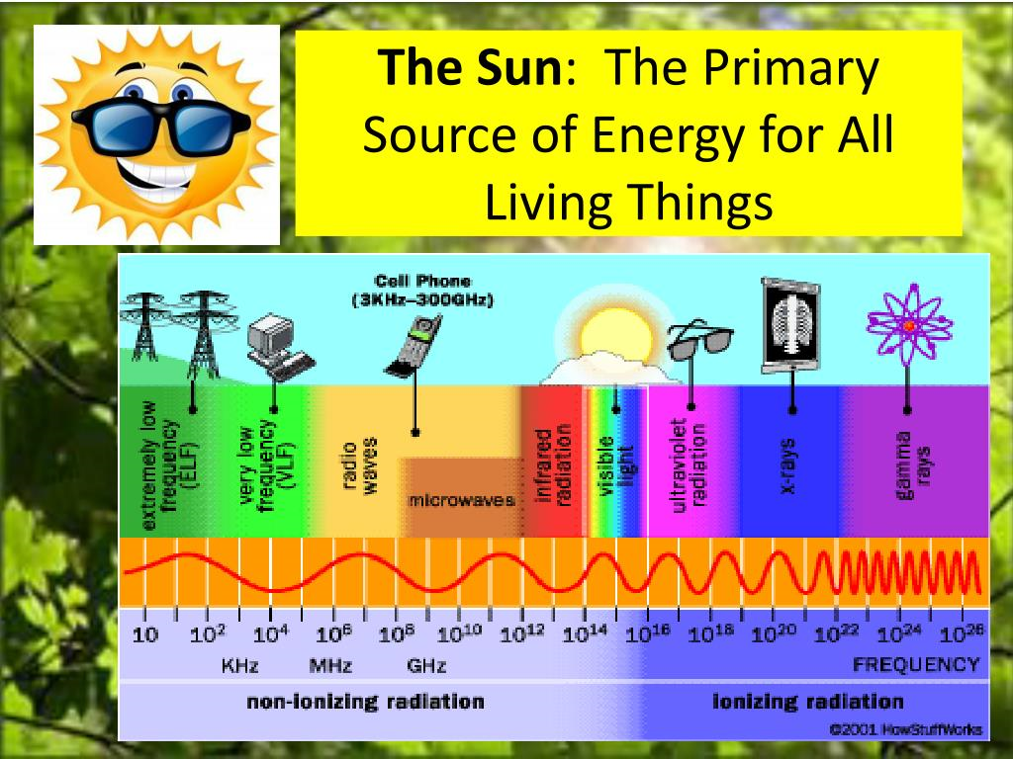

Slide 7
Energy types & Uses
Electrical energy produced in several ways, powers transport, artificial lighting, agriculture and industry.
This comes from hydel power based on the water cycle that is powered by the sun’s energy that supports evaporation, or
from thermal power stations powered by fossil fuels.
Nuclear energy is held in the nucleus of an atom and is now harnessed to develop electrical energy

Slide 8
Energy types & Uses
We use energy for household use, agriculture, production of industrial goods and for running transport.
Modern agriculture uses chemical fertilizers, which require large amounts of energy during their manufacture.
Industry uses energy to power manufacturing units and the urban complexes that support it.
Energy-demanding roads and railway lines, airlines for transportation.

Slide 9
Video :
FACTS ABOUT SUN – Solar Energy

Slide 10
Problems Associated with energy resources
All energy use creates heat and contributes to atmospheric temperature.
Many forms of energy release carbon dioxide and lead to global warming.
Nuclear energy plants have caused enormous losses to the environment due to the leakage of nuclear material.
The inability to effectively manage and safely dispose of nuclear waste is a serious global concern.

Slide 11
For almost 200 years, coal was the primary energy source fuelling the industrial evolution in the 19th century.
At the close of the 20th century, oil accounted for 39% of the world’s commercial energy consumption, followed by coal (24%) and natural gas (24%), while nuclear (7%) and hydro/renewables (6%) accounted for the rest.
At present 65 percent of the world’s oil reserves are located in the Middle East.
In India, biomass (mainly wood and dung) accounts for almost 40% of primary energy supply
Among the commercial energy sources used in India, coal is a predominant source accounting for 55% of energy consumption estimated in 2001, followed by oil (31%), natural gas (8%), hydro (5%) and nuclear (1%).

Slide 12
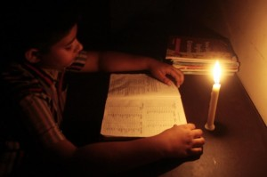
At present almost 2 billion people worldwide have no access to electricity at all.
While a large proportion of energy from electricity is wasted during transmission as well as at the user level.
In 1998, the World Resources Institute found that the average American uses 24 times the energy used by an Indian.

Slide 13
Types of energy:
Renewable energy : Hydropower, solar, wind, and geothermal, biomass and energy from waste
Non-renewable energy : coal, oil, natural gas
Nuclear energy : Uranium(U), Thorium(Th)
One day, all our homes may get their energy from the sun or the wind.

Slide 14
Energy resources
Non-renewable energy resources:
coal, oil, natural gas and its impacts
The Exxon Valdez was wrecked in Prince William Sound in Alaska on March24th.1989 and polluted large parts of the surrounding seas.
During the Gulf War, oil installations burned for weeks polluting the air with poisonous
gasses. The fires wasted 5 million barrels of oil and produced over a million tons of air-
borne pollutants, including sulphur dioxide, a major cause of acid rain.

Slide 15
Coal and its environmental impacts:
Coal is the world’s single largest contributor of greenhouse gases and is one of the most important causes of global warming.
Many coal-based power generation plants are not fitted with devices such as electrostatic precipitators to reduce emissions of suspended particulate matter (SPM) which is a major contributor to air pollution.
Burning coal also produces oxides of sulphur and nitrogen which, combined with water vapour, lead to ‘acid rain’.
This kills forest vegetation, and damages architectural heritage sites, pollutes water and affects human health.

Slide 16
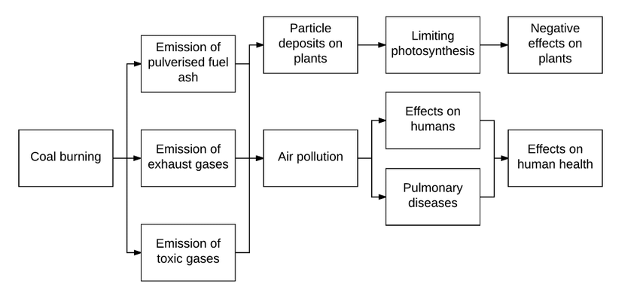
Thermal power stations that use coal produce waste in the form of ‘fly ash’. Large dumps are required to dispose off this waste material, while efforts have been made to use it for making bricks.

Slide 17
Renewable energy resources
Hydroelectric Power
Solar energy
Solar thermal
. Solar water heating, . Solar heating for homes
. Solar cookers. . Solar desalination
. Solar thermal electric power
Photovoltaic energy
Biomass energy (One ton of biomass produces 85 cu.m. of biogas)
Wind energy
Tidal and Wave energy
Geothermal energy
Nuclear energy

Slide 18
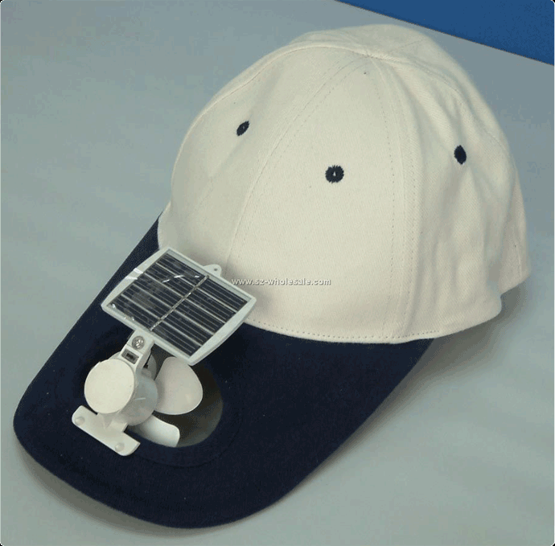
Cap

Slide 19


Slide 20
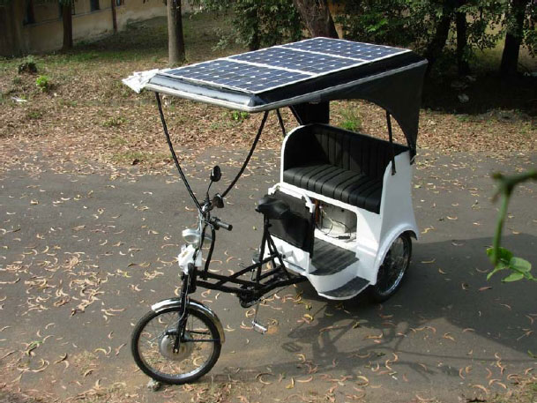
Rickshaw

Slide 21
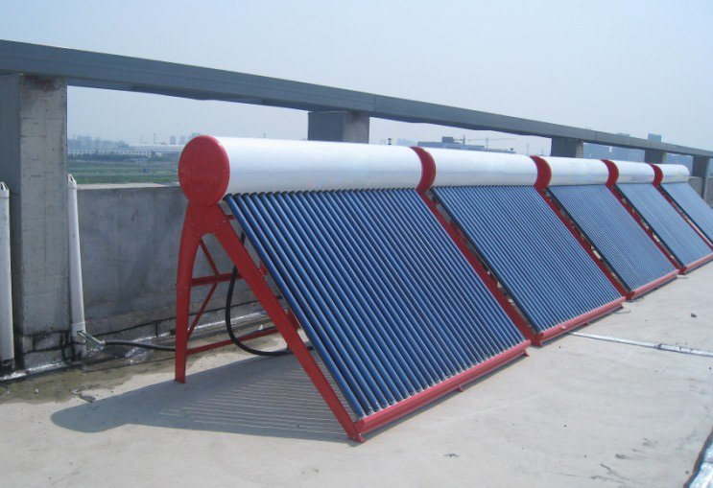
Solar water heater

Slide 22
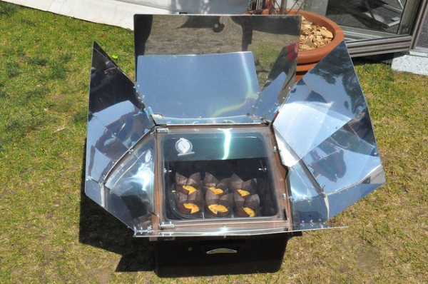
Solar oven

Slide 23
Energy Conservation
Indian industries use more energy than necessary.
Steel and energy: To produce one tonne of steel, India spends 9.5 million kilocalories. In Italy it is 4.3 million kilocalories and for Japan it is only 4.1 million kilocalories.
Cement industry: Over 2 million kilocalories are used to produce one tonne of cement in India. In Germany it is 0.82 million kilocalo- ries, in USA, 0.92 million kilocalories.
Vehicles: Lighter materials should be used for cars. Instead of steel we should use aluminum, fiber glass or plastics. These lighter materials can reduce the weight by 15 % and increase the fuel economy by 6 to 8%.
Refrigerators: Better technologies reduced the annual energy needed by a typical Danish 200 liter refrigerator (with no freezer) from 350 kilo Watt hour (kWh) to 90 kWh.
Lighting: An 18-watt modern, compact fluorescent lamp, can replace a standard 75-watt incandescent lamp. And role of LED in power saving

Slide 24
What can you do to save electricity?
Turn off lights and fans as soon as you leave the room.
Use tube lights and energy efficient bulbs that save energy rather than bulbs. A 40 watt tube light gives as much light as a 100 watt bulb.
Keep the bulbs and tubes clean. Dust on tubes and bulbs decreases lighting levels by 20 to 30 percent.
Switch off the television or radio as soon as the program of interest is over.
A pressure cooker can save up to 75 percent of energy required for cooking. It is also faster.
Keeping the vessel covered with a lid during cooking, helps to cook faster, thus saving energy.

Slide 25
ROLE OF AN INDIVIDUAL IN CONSERVATION OF NATURAL RESOURCES
The two most damaging factors leading to the current rapid depletion of all forms of natural resources are increasing ‘consumerism’ on the part of the affluent sections of society, and rapid population growth.
What will we leave to our children? (Are we thinking of short-term or long-term Gain?)
Is my material gain someone else’s loss?

Slide 26
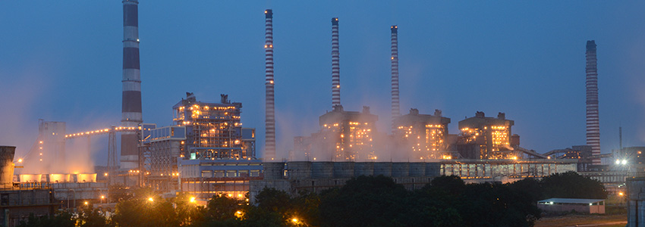
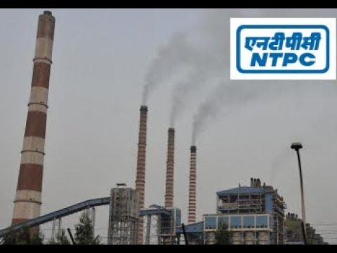
NTPC Ramagundam (Thermal power plant )

Slide 27
Renewable energy Resources
Renewable energy systems use resources that are constantly replaced and are usually less polluting.
Examples : hydropower, solar, wind, and geothermal (energy from the heat inside the earth).
We also get renewable energy from burning trees and even garbage as fuel and processing other plants into biofuels.

Slide 28
Hydroelectric Power
This uses water flowing down a natural gradient to turn turbines to generate electricity known as ‘hydroelectric power’ by constructing dams across rivers.
Between 1950 and 1970, Hydropower generation worldwide increased seven times.
Advantages:
The long life of hydropower plants,
the renewable nature of the energy source,
very low operating and maintenance costs, and
absence of inflationary pressures as in fossil fuels.

Slide 29
Drawbacks:
i). Although hydroelectric power has led to economic progress around the world, it has created serious ecological problems:
To produce hydroelectric power, large areas of forest and agricultural lands are submerged.
These lands traditionally provided a livelihood for local tribal people and farmers. Conflicts over land use are inevitable.

Slide 30

Drawbacks of hydroelectric power…
ii). Silting of the reservoirs (especially as a result of deforestation – blockage with silt) reduces the life of the hydroelectric power installations.
iii). Water is required for many other purposes besides power generation.
These include domestic requirements, growing agricultural crops and for industry. This gives rise to conflicts

Slide 31
iv). The use of rivers for navigation and fisheries becomes difficult once the water is dammed for generation of electricity.
v) Resettlement of displaced persons is a problem for which there is no ready solution.
vi). In certain regions large dams can induce seismic activity which will result in earthquakes.
> There is a great possibility of this occurring around the Tehri dam in the Himalayan foothills.
> Shri Sunderlal Bahuguna, the initiator of the Chipko Movement has fought against the Tehri Dam for several years.

Slide 32
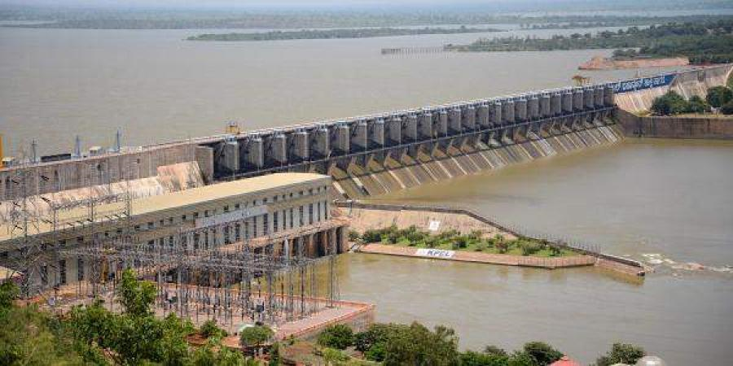
SRISAILAM HYDRO ELECTIC POWER STATION

Slide 33
With large dams causing social problems, there has been a trend to develop small hydroelectric generation units.
Multiple small dams have less impact on the environment.
China has the largest number of these - 60,000, generating 13,250 megawatts, i.e. 30% of China’s electricity.
Sweden, the US, Italy and France also have developed small dams for electrical power generation.
The development of small hydroelectric power units could become a very important resource in India.

Slide 34
Solar energy:
In one hour, the sun emits as much energy onto the earth as we use in a whole year.
If it were possible to harness this colossal quantum of energy, humanity would need no other source of energy.
Today we have developed several methods of collecting this energy for heating water and generating electricity

Slide 35
Solar heating for homes:
Modern housing that uses air conditioning and/ or heating are extremely energy dependant.
Sunspaces are built on the south side of the structure which act as large heat absorbers.
The floors of sunspaces are usually made of tiles or bricks that absorb heat throughout the day, then release heat at night when its cold.

Slide 36
Solar water heating:
Most solar water-heating systems have two main parts:
the solar collector and
the storage tank.
The solar energy collector heats the water, which then flows to a well insulated storage tank.

Slide 37
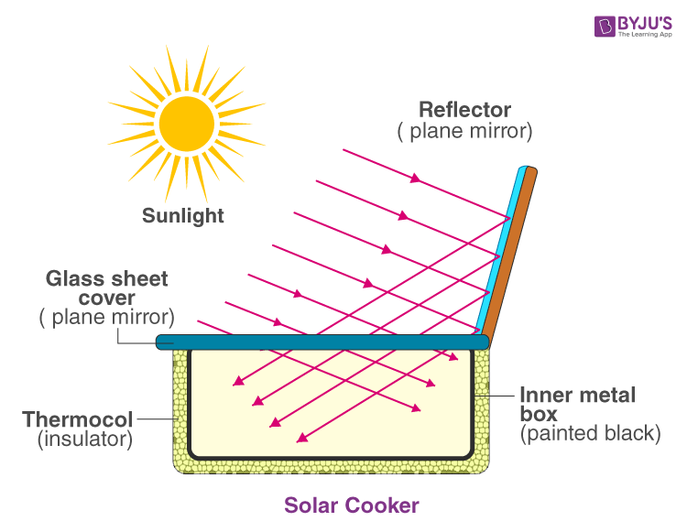
Solar cookers: The heat produced by the sun can be directly used for cooking using solar cookers.
A solar cooker is a metal box which is black on the inside to absorb and retain heat.
The lid has a reflective surface to reflect the heat from the sun into the box.
The box contains black vessels in which the food to be cooked is placed.
India has the world’s largest solar cooker program and an estimated 2 lakh families that use solar cookers.

Slide 38
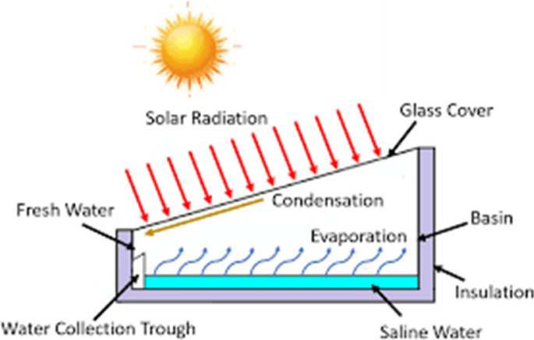
Other Solar-Powered Devices:
Solar desalination systems (for converting saline or brackish water into pure distilled water) have been developed.
In future, they should become important alternatives for man’s future economic growth in areas where fresh water is not available.

Slide 39
Photovoltaic energy:
The solar technology which has the greatest potential for use throughout the world is that of solar photo voltaic cells which directly produce electricity from sunlight using photovoltaic (PV) (also called solar) cells.
Solar cells use the sun’s light, not its heat, to make electricity.
PV cells require little maintenance, have no moving parts, and essentially no environmental impact.
They work cleanly, safely and silently.

Slide 40
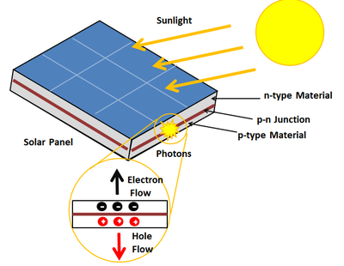
PV cells
Solar cells are made up of two separate layers of silicon, each layer contains an electric charge.
When light hits the cells, the charges begin to move between the two layers and electricity is produced.
PV cells are wired together to form a module.
A module of about 40 cells is enough to power a light bulb.
For more power, PV modules are wired together into an array.
PV arrays can produce enough power to meet the electrical needs of a home.

Slide 41
Photo voltaic cell

Slide 42
Uses of PV CELLS
PV cells are used in calculators and watches.
They also provide power to satellites, electric lights, and
small electrical appliances such as radios and for water pumping,
highway lighting, weather stations etc.

Slide 43
__________________
Thank you

